Slide 1
Messaging Patterns on Azure
Using Service Bus, Event Hubs, Event Grid, and Relay
Clemens Vasters (@clemensv)
Principal Architect, Azure Messaging

Slide 2
Azure Messaging Suite
Service Bus
Event Grid
Event Hubs
Relay

Slide 3





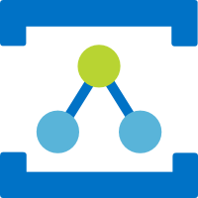
Eventing and Messaging Core Services
Push-style distribution of discrete events to serverless workloads
Event Grid
HTTP (AMQP/WS)
Message Oriented Services
Pull-style, queue-based transfer of jobs and control via message queues and topics
Service Bus
HTTP AMQP/WS
Partitioned, high-volume, tape-drive-style sequential recording and unlimited, pull-style re-reads of event streams.
Event Hubs
HTTP AMQP/WS KRPC
Discovery and connectivity service for securely bridging streams across network boundaries in hybrid edge/cloud scenarios.
Connectivity Services
Relay
WS

Slide 4

Service Bus Architectural Patterns
Assignment of work with load-aware balancing
Load-leveling for “spiky” workload traffic shapes
Transactional, once-and-only-once processing
Multiplex handling of in-order message sequences
Deduplication, deferral, and “poison” handling
Queues
HTTP AMQP/WS
All of the above, plus:
Copies to 100s of concurrent subscribers
Filter rules and message markup
Message routing
Topics
HTTP AMQP/WS
Service Bus is a “swiss army knife” for messaging-driven workloads.

Slide 5



Competing Consumers
Observing the queue length trends allows spinning up further resources as needed to handle exceptional load.
Web
Business Process
Web
Business Process
Web
Queue
Business Data
Web
Competing Consumers Pattern Messages get distributed amongst competing receivers. Exclusive ownership of message.

Slide 6
Load Leveling
Offline / Batch Pattern Work jobs can be queued up and processed periodically. Processor may be offline.
Adding a message queue allows the business process to handle transactions at optimal capacity use and without getting overwhelmed
Spiky loads are buffered by the queue until the processor can handle them
Web
Web
Business Process
Web
Queue
Business Data
Web
Load Leveling Pattern Uneven transaction load distribution is leveled out; processor proceeds at robust pace

Slide 7
Demo: Service Bus Key Patterns
Competing Consumer Publish/Subscribe Routing Session Multiplexing

Slide 8
Event Hubs Architectural Patterns
Ingestion and storage of large event streams
> 2 Gigabyte per second if required
Separation of event streams into partitions
Client-chosen offsets into event stream allow arbitrary reads and re-reads during retention
Retention of raw event data from 1 up to 90 days
Automated archival into Avro containers for subsequent batch-style processing
Publisher policies for data origin attestation and access control
Event Hub (IoT Hub)
HTTP AMQP/WS KRPC (Kafka)
Event Hubs is a high-scale, high-availability, multi-protocol event stream engine used for collecting and consolidating events for real-time analytics and other high-throughput computations

Slide 9
Event Data Value – Securities Markets
Data Depth Value
Timeliness Value

Slide 10









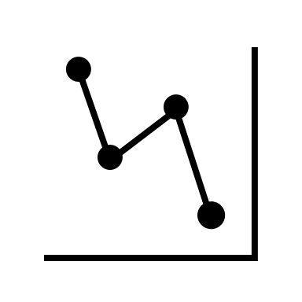


Velocity Matters ➔ Parallelization Matters
Occurrences
Capture
(optional) Shape Enrich, Reduce, Validate, Filter
Disseminate
Analyze, Visualize, React
parallelization
Event data age, processing latency

Slide 11

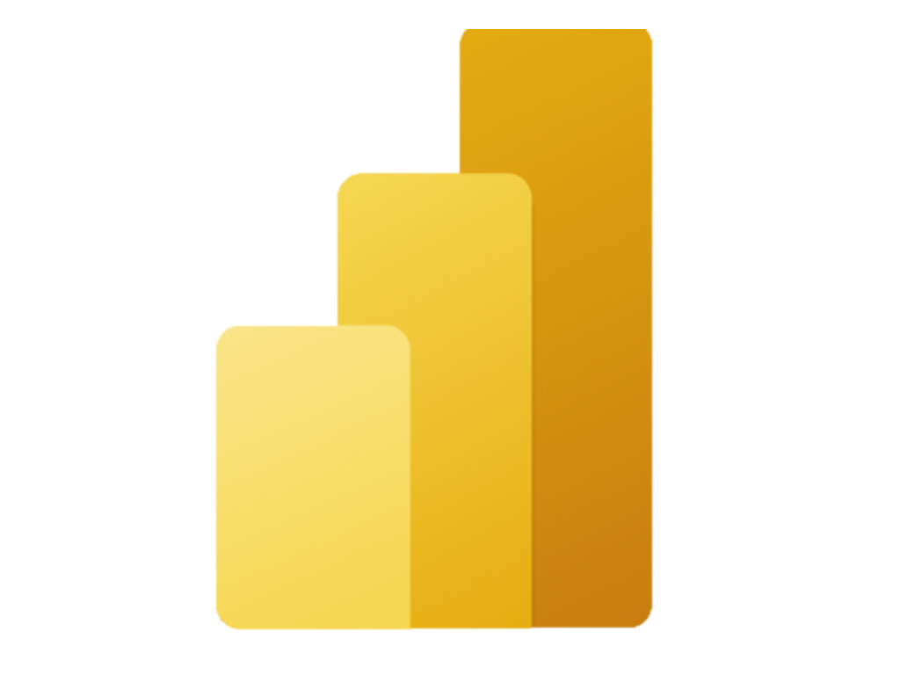


Event Streams and Context
Real-time dashboards show ad-hoc available data
210025
Event Hub
220043
326047
Straight-Through Real-Time
491092
Aggregate
Visualize
201092
Efficient on-demand queries require indexing and random access
241113
Refer
721215
251289
721215
231211
2021-01-04 16:30-18:30
On-Demand
822251
Oil Pressure
332271
Store & Index

Slide 12
Demo: Event Hubs Key Patterns
Client-Based Offsets Partitions Collaborative Processing Batch Capture

Slide 13
Event Grid Architectural Patterns
Ingestion and push-style distribution of discrete events (events not correlated into streams) to interested subscribers.
Per-subscriber application of simple and complex filters to select particular events of interest
Abuse protection for event publishers
Event schema mapping and support for CNCF CloudEvents 1.0 standard and bindings
Multitenancy support for SaaS applications.
Simple integration with a catalog of available event sources and sinks.
Event Grid
HTTP AMQP/WS
Event Grid is the Azure-wide eventing backplane for distributing and handling discrete events raised at the platform level, by custom applications, and by partner platforms.

Slide 14
Demo: Event Grid Key Patterns
Topics Push-Based WebHook Subscriptions Push-Based Service Bus and Event Hubs Subscriptions Cloud Events

Slide 15
Relay Architectural Patterns
Expose (micro-) services, databases, and other endpoints from private networks on a public network endpoint without requiring VPN connectivity and/or DNS integration.
Ad-hoc discovery of endpoints with dynamic network addresses
Firewall and NAT traversal for one or both communicating parties
Endpoint-level bridging across Azure VNet
“Azure Bridge” runtime allows for bridging UDP, TCP, and Unix sockets
Relay
WS

Slide 16


Hybrid Cloud/On-Premises Integration
Cloud App
Generic “Synchronous Access” Integration without VPNs App Service Hybrid Connections Azure Relay Bridge
Database Access
RPC Services
RDP/VNC Bridging
On-Prem & Firewalled Assets

Slide 17
Cross-Site Federation (eg. SaaS)
SaaS or Central System
Site Integration for SaaS & PaaS
App Service Hybrid Connections
Azure Data Gateway
Vending machines
Point of sale systems
Tax/Law/Medical office integration
Ticket sales
Tenant On-Prem Assets
Tenant On-Prem Assets

Slide 18
Franchise and Partner Integration
Commerce Site
Central On-Site Assets (Call Centers, Delivery)
Partner
Partner
Partner
Franchise and Partner Integration
Food order & delivery
“Click and collect” sales
Transportation

Slide 19
Mobile Workforce/Customer Integration
Web & Mobile Devices
Mobile Device Gateway
Mobile App Solution
Mobile Workforce Enablement
Core applications remain on-site for a variety of reasons
Web & mobile access through cloud-based gateways
On-Prem Assets

Slide 20
The Bigger Picture

Slide 21






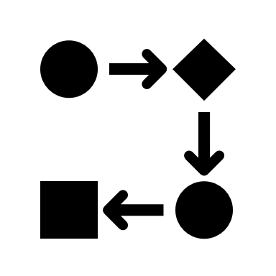




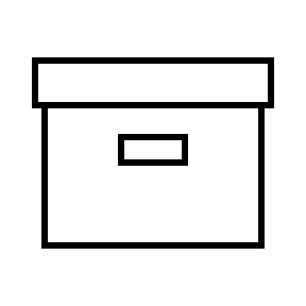



Event Journeys
Real-Time Capture and Dispatch
Stateful Analysis and AI
Dashboards and Apps
Serverless Shaping
Streaming SQL
Field Gateways
Event Router
Indexed Streams
Functions and Workflows
AMQP
Edge Platforms and Apps
MQTT
A
HTTP
B
CloudEvents
Open, Vendor- Neutral, Product-Neutral
Standards
Network-Embedded Services
Flat Log Projections
Cool/Cold Archive
Event Log Store
5G
K
V
K
V
K
V
Load-Leveling, Fast Storage,
Parallelization “Catching Rain”
K
V
K
V
K
V

Slide 22

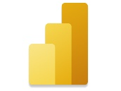








Event Journeys
Device Status Change or Alarm
CO PPM over threshold
Web site visitor statistics
Advertisement clicked
Package delivery
Package scanned

Slide 23
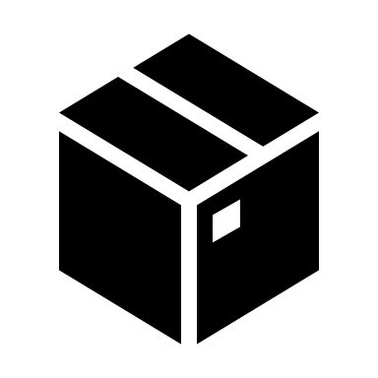

Eventing Platform Building Blocks
SaaS Platform Integration
Open, Vendor-Neutral, Product-Neutral Protocols
Stateful Analysis and AI
Dashboards and Apps
ERP
CRM
HR
AMQP
MQTT
HTTP
Collaboration
Web Sockets
CloudEvents
Streaming SQL
EDI Integration
Event Stream Capture and Streamed Delivery
Indexed Streams and Batches
Functions, Jobs, and Workflows
X12
HIPAA
XML
A
EDIFACT
EANCOM
B
Database Change Capture
Discrete Event Capture and Subscriber Delivery
Flat Log Projections
Cool/Cold Archives
SQL
Oracle
Teradata
K
V
K
V
IBM DB2
Redshift
Postgres
K
V
K
V
Cosmos DB
Mongo DB
K
V
K
V

Slide 24
























Eventing on Azure Cloud
SaaS Platform Integration
Open, Vendor-Neutral, Product-Neutral Protocols
Stateful Analysis and AI
Dashboards and Apps
EDI Integration
Event Stream Capture and Streamed Delivery
Indexed Streams and Batches
Functions, Jobs, and Workflows
Database Change Capture
Discrete Event Capture and Subscriber Delivery
Flat Log Projections
Cool/Cold Archives

